Slide 1


Implementing and Interfacing with KVM
HPC Cluster Engineering Academy
Mentor: Dave Fox
Ben Ryan
bpryan@email.wm.edu
Cristian Palomo-Ramirez
cpalomo-ramirez@csumb.edu
August 13, 2020

Slide 2
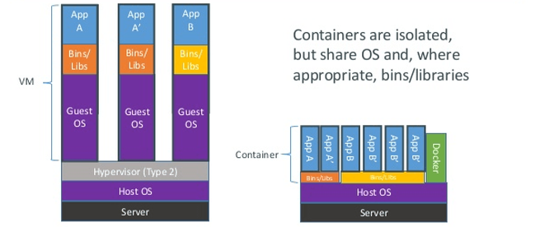
What is a virtual machine?
At the highest level, a virtual machine (VM) is an emulation of a computer system.
A virtual machine requires a hypervisor, which separates the physical hardware/host OS from a guest VM.
Bare-metal (Type 1) vs. Hosted hypervisors (Type 2)
Container systems (for example), are somewhat similar to a VM with a hosted hypervisor, but not the same.
(Hosted hypervisor) VM vs. Docker
Credit: VirtualizationSoftware.com
Notes:
A virtual machine, or VM, is an emulated system that runs in conjunction with a host operating system and physical hardware. The hypervisor is the hardware or software layer that separates physical hardware from the OS to allow for creation of virtual machines, of which there are two types. A hypervisor is considered "bare metal" (or type 1) when it runs directly on the hardware, as opposed to a hosted hypervisor (or type 2) which runs on the OS like any other program.
Bare-metal hypervisors provide more efficient usage of resources than hosted hypervisors. Bare-metal based VMs are therefore more efficient for smaller or specialized tasks, ease of testing configurations prior to deployment of new technology. Both types of hypervisor allow a VM to mitigate the need for new physical hardware in cases where a small task might have required additional hardware that would not have been fully utilized, such as a hard drive for a small server.
Recently, the use of container interfaces such as Docker have become popular. These programs typically work in a similar way to a hosted hypervisor VM, with the most major difference being that they, while they are more isolated than a standard process, they share an OS and potentially other resources, while a VM has its own OS.

Slide 3
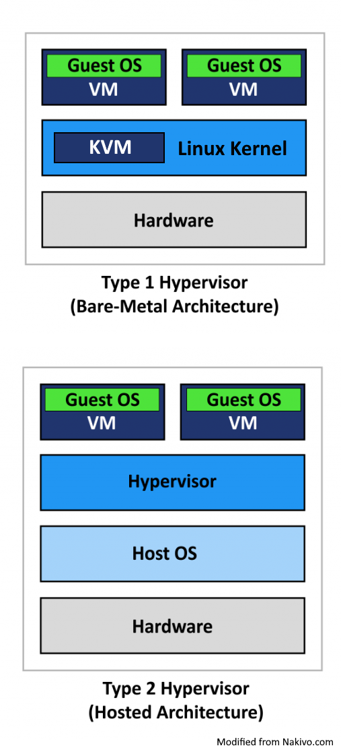
What is KVM and why is it useful?
A Kernel-based Virtual Machine (KVM) is a type of VM that turns the Linux kernel into a bare-metal hypervisor.
KVM allows the host machine to treat every guest (VM) as if it were a Linux process.
Some of the benefits of a bare-metal VM are efficient usage of resources for smaller, specialized tasks, ease of testing, etc.
The main benefits of KVM specifically is that it is built into Linux and is extremely efficient.
Notes:
Kernel based virtual machines, or KVM, is a type of virtual machine that uses the Linux kernel as a bare-metal hypervisor. This allows the host machine to treat every VM, called a ‘guest’, as if it were a Linux process. Therefore, every guest has the same level of access to physical hardware as any other process and can easily and efficiently be used thanks to tools that Linux already has built in, such as the task scheduler.
The main benefits of KVM specifically is that it is built into Linux and is extremely efficient considering that the Linux kernel acts as the hypervisor, meaning it has inherently unrestricted access to the physical hardware and Linux tools. This in turn provides features for enhanced security, scaling, and uninterrupted host migration.

Slide 4
Goals
Set up nodes in student cluster environment to run KVM
Develop process to build and deploy VMs with various operating systems with automation
Apply these tools and process to real world use

Slide 5
Node setup
Make sure CPU supports hardware virtualization
Enable virtualization in BIOS of host machine.
Install required packages
Enable libvirt on startup
Check KVM module has loaded properly
Allocate new IP and name for guest machines
Notes:
Cristian

Slide 6
Implementation Red hat-based installations
Download desired ISO from mirror
virt-install is the command line tool for creating new guest VMs
Run the virt-install command with required flags to define guest specifications
Example: virt-install --name c7console --ram 1024 --vcpus=2 --os-variant=centos7.0 --location=/var/lib/libvirt/boot/CentOS-7-x86_64-DVD-2003.iso --nographics --disk path=/var/lib/libvirt/images/c7console.qcow2,size=8,bus=virtio,format=qcow2 --extra-args="console=ttyS0"
Notes:
Talk about docker vs kvm (bare metal vs hosted) on this slide, add a graphic for this
Cristian

Slide 7
Implementation Debian-based installations
Debian system installations are similar with a few differences
Debian iso image needs to be booted with –cdrom flag; --location will not work
Solution: Use --location flag
Unlike in Red-hat based systems, serial terminal does not get auto configured in install.
Solution: SSH into guest and edit file to change GRUB terminal to console.
GUI of the guest instance can be accessed by removing the --nographics flag and using virt-manager
Notes:
Talk about docker vs kvm (bare metal vs hosted) on this slide, add a graphic for this
Cristian

Slide 8
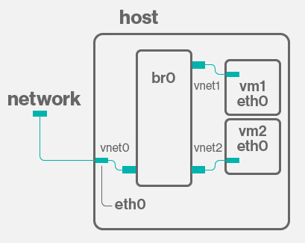
Networking with guests
Virtual machines run on virtualized networks that do not inherently connect to a host's physical network.
A bridge device can be created on a port of a physical network switch.
The physical network looks at a given port which the bridge exists on, and the bridge assigns IP/network properties to guests and tell guests to look for the bridge as their network interface, then the physical and virtual networks can communicate.
Bridge interface connecting a physical and virtual network.
Credit: AskUbuntu.com
Notes:
Most VMs would simply not be useful if they could not communicate with other local machines or the wider internet. VMs are emulations, and therefore, any network interfaces that a guest might posses are virtual themselves. To connect a virtual network to a physical network, a bridge device must be set up to allow communication between the two.
For example, If you were to set up a basic guest machine using the methods we have described, in order to interface on the physical network that the cluster itself utilizes, you would have to define a new bridge. The clusters as the Academy has configured them have a backend Ethernet network as well as an infiniband network. The Ethernet network is managed by a physical switch, and the nodes use the em1 interface to access that switch. If we create a virtual bridge device that assigns and passes IP addresses via DHCP, then instruct em1 to look for that bridge device, we have essentially created that bridge between the physical and virtual networks. To visualize this, it would be as though the port that a given node physically occupies on the Ethernet switch now acts as a virtual switch itself, assigning multiple virtual ports to one physical one that the VMs can occupy. The virtual bridge device br1 'bridges' the physical network via em1 to the virtual network that the VMs share.

Slide 9
KVM guest automation
Installing operating systems and configuring guests can be time consuming and error prone.
The installation command that defines the emulated properties of a guest (RAM, CPU count, network, etc.) can be automated via BASH scripting.
A preconfiguration file can also be provided to preconfigure OS properties, install packages, set up users, etc.
On CentOS/RHEL distributions, this is called 'Kickstart'. Ubuntu/Debian supports 'preseed' and OpenSUSE/SLES supports 'AutoYaST'.
Combining automation tools allows for a guest to be deployed to the exact specifications and needs of the user with little input and less room for error.
Notes:
Now, as you might imagine, installing different distributions of Linux or any other OS on a guest is a time-consuming and error prone process. Furthermore, certain scenarios might need even more robust control over the OS that is installed, such as the kernel version. Without automation of the installation process, use of VMs for testing over various hardware and software configurations would not be practical.
While one could install a guest via a GUI tool, using the libvirt package and ‘virt-install’ command opens the possibility of automation through BASH scripting and Ansible. Creating a script that can run the command that defines and creates a virtual machine, especially if it has capabilities to accept user input, means that a lengthy command need not be typed repeatedly.
However, one would still have to proceed manually through the installation prompts of the OS. Many Linux distributions provide a way to automate the actual installation through preconfiguration files. The file can be injected into an operating system’s ISO or network install file with a simple addition to the ‘virt-install’ command. These files provide instructions on OS configurations, packages to be installed, users to be defined, just to name a few, that will allow the installer to run without any user intervention. Therefore, the resulting guest will be fully configured from the original ‘virt-install’, completely automated. Some common forms of preconfiguration files are Kickstart for CentOS/RHEL-based distros, preseed for Ubuntu/Debian, and AutoYaST for OpenSUSE/SLES.

Slide 10
Other tools
Virsh commands:
List of running guests
Destroy target guest
Connect to a guest
virt-manager is the GUI tool used to manage VMs
Can be used along with RealVNC to access a virtual desktop of guest machines.
oVirt
Notes:
Cristian

Slide 11
Outcomes
Guest implementation of various Linux distros
Required packages
Test user with sudo privileges
Automation of guest system installations
Base image creation
Detailed documentation for future administrator use/maintenance
Guest implementation of various Linux distros
Required packages
Test user with sudo privileges
Automated installation
Documentation for future admin use/maintenance
Notes:
Cristian

Slide 12
Plans for future
Set up a guest with TOSS
Integrate VMs to set up environments for testing MSR-safe kernel modules
Respond to Gitlab Continuous requests
Use script/tool to run the CI request on the allocated image
Capture results and logs
Deallocate and clean up the instance.

Slide 13
Disclaimer
This document was prepared as an account of work sponsored by an agency of the United States government. Neither the United States government nor Lawrence Livermore National Security, LLC, nor any of their employees makes any warranty, expressed or implied, or assumes any legal liability or responsibility for the accuracy, completeness, or usefulness of any information, apparatus, product, or process disclosed, or represents that its use would not infringe privately owned rights. Reference herein to any specific commercial product, process, or service by trade name, trademark, manufacturer, or otherwise does not necessarily constitute or imply its endorsement, recommendation, or favoring by the United States government or Lawrence Livermore National Security, LLC. The views and opinions of authors expressed herein do not necessarily state or reflect those of the United States government or Lawrence Livermore National Security, LLC, and shall not be used for advertising or product endorsement purposes.

